Slide 1
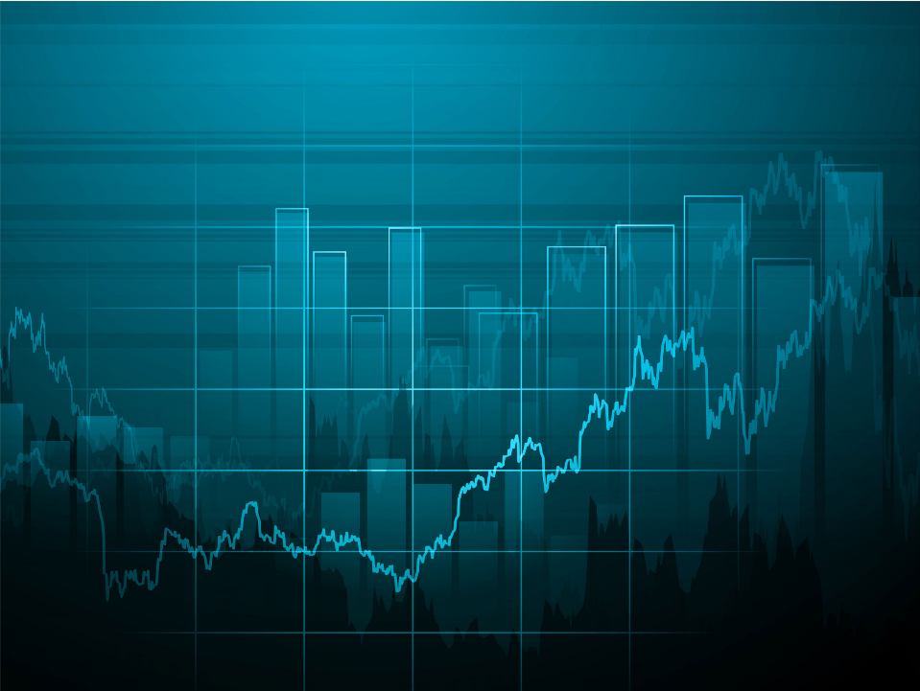

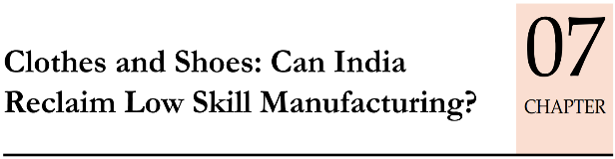

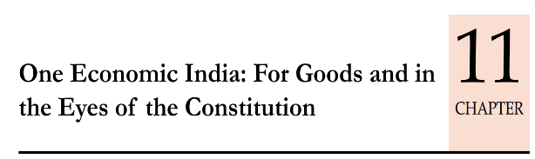
Economy: 6 pillars + theory + current + BES17 (pre cum Mains)
1.Banking, Fin, Insur.
6.HRD
2.Budget
3.BoP
4.Sectors
5.Infra
V1:c3,4
V1:c2,3, 6,9,11(GST),13
V1c:5
V1c:7(Textile),11(trade)
V1c:10
v1c:12, 14; Budget^Rail
11 pages bol-bachchan ► 12 slides
33 pages bol-bachchan ► 13 slides

Slide 2
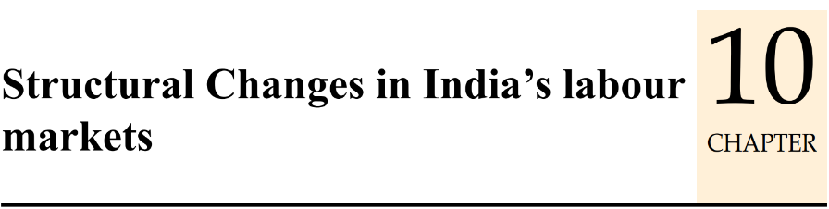
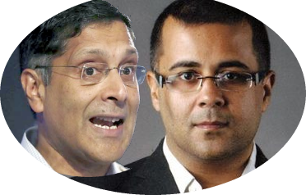

Survey 2015-16 [BES16]
Textile firms should shift to smaller town to use women labour force freed from agriculture
Apr. 2017: ES part of Mumbai Uni.
B.A (Economics)
Apr. 2017: 5 Pt someone in DU
BA (English)
Survey 2016-17 [BES17]
11 pages bol-bachchan ► 12 slides

Slide 3
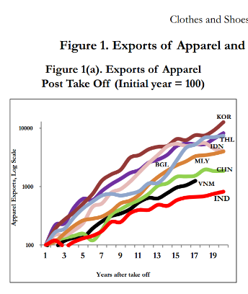
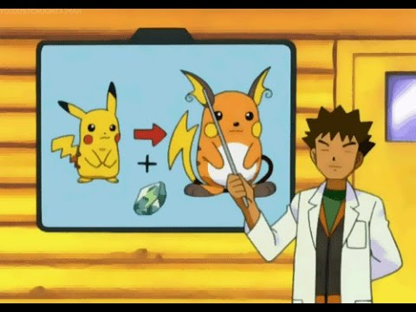

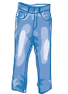
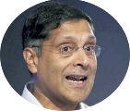

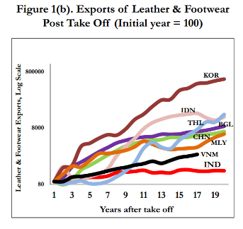

Post WW2: East Asian economies: Authoritarianism, Washington Consensus, Focus on low skill mfg: cloths-shoes, Jeans…but India did not.
Dekho, these countries focused on clothes & shoes mfg. so, their Pokémons evolved. Only India is like “Pikachu”, that it's not evolving into "Raichu“,
because we did not focus on cloths and shoes ☹.

Slide 4




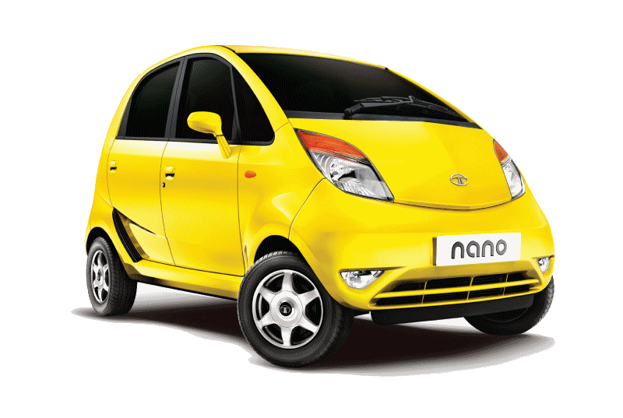

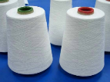
If Rs.1 lakh invested in a sector…
Besides, Post TBS/NPA: investment has declined in these sectors!

Slide 5
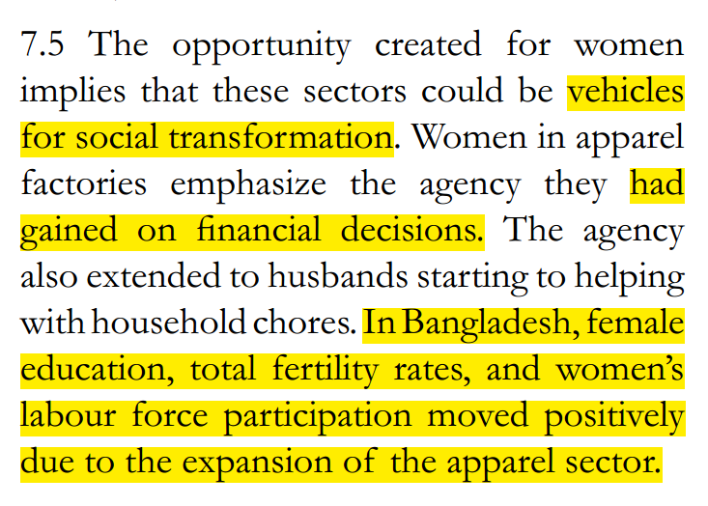
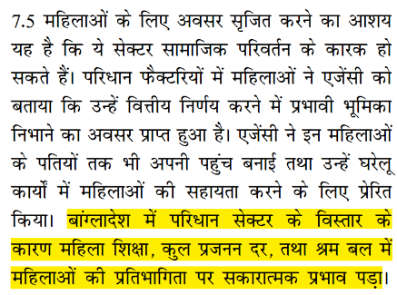
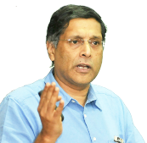
Benefits?
Rurbanization: Villages -> smaller towns= ♀ Agriculture work ▼; these two are most ♀ friendly
Skill: sewing, stitching, patience & color perception.
flexibility of workhours, incl. work @home during [maternity benefit Act 2017].

Slide 6
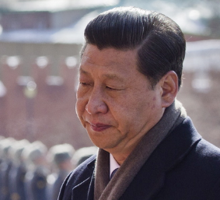
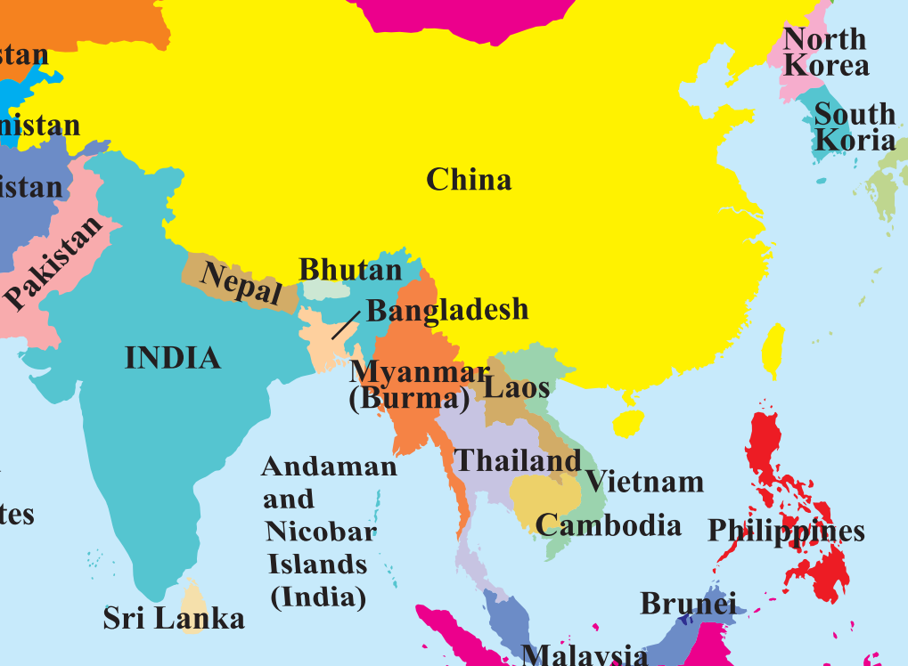
Demographic dividend ▼,
Ageing population =Labour cost▲
2015: stock market crash Mfg ▼

Slide 7
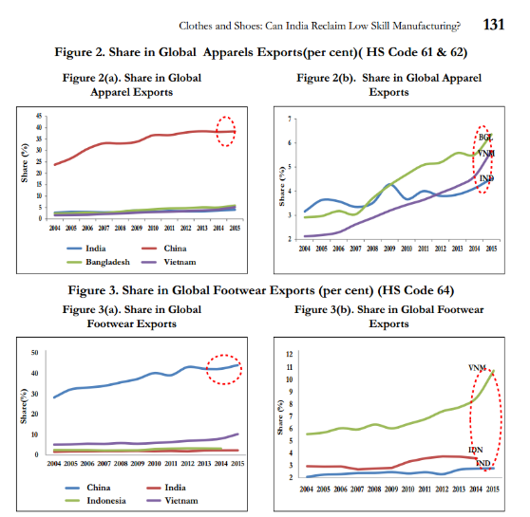
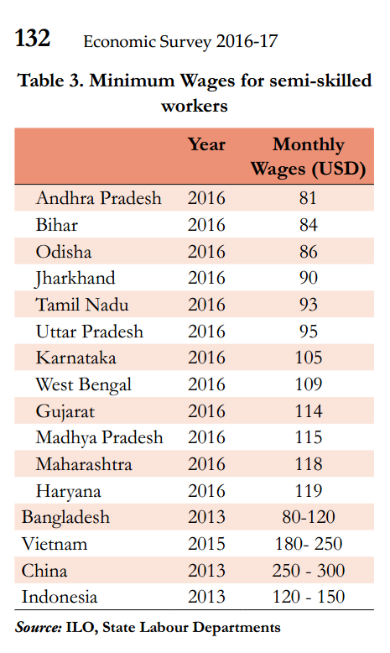


Now China slowdown + ▲ labour costs..so vaccum
But Bangladesh cloths growing more
But Vietnam footwear growing more
Our wages are 1/3rd of China..

Slide 8
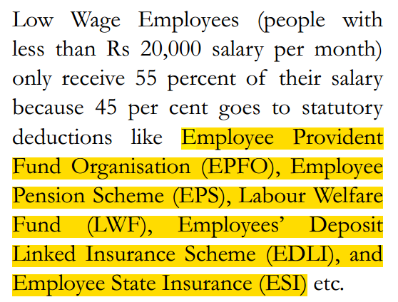
Wage Structure for Employee with < 20k salary / per month..
Plus employer also has to contribute 12% from his pocket as well.
End result:
Long term SS but workers prefer short term liquidity
Informal jobs on verbal contract
Companies to remain “small” on paper .

Slide 9
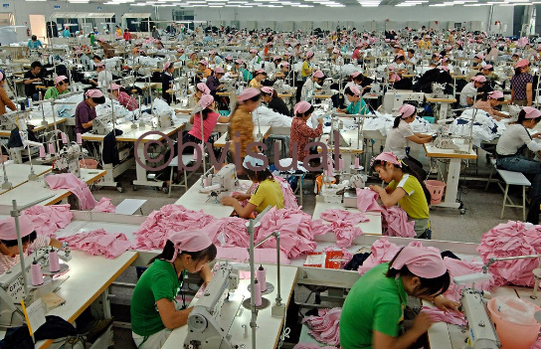
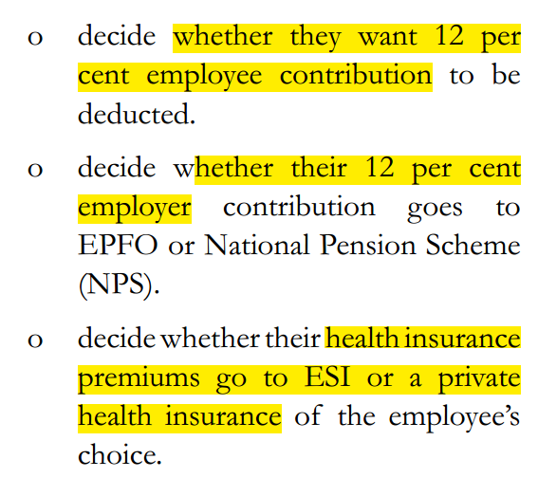
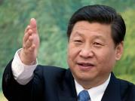

Firms with >500 workers= ▲ economies of scale, ▼per unit cost..
MSME upto Rs.1.5cr excise exempt
Bigger co = More EPFO and factory inspector raj, compliance cost.
Hence survey recommended …
Why Indian entrepreneurs prefer to remain “Small”
Formal Registered ‘workers’ = company also has motivation to invest on their ‘training’ because it’ll ▲output. ☺
Informal worker = no incentive to train, cause he’ll leave the job randomly! ☹
Notes:
Regulatory cholesterol
Factory act provisions, EPFO. [Now Govt agreed to contribute employer’s 15% in EPFO* ]
No incentive to grow “large”, because more employees= more amnesties and inspector raj
Result: firms prefer to remain ‘small’
India: Only 10% firms have >500 employees
China: 28% = economies of scale.

Slide 10
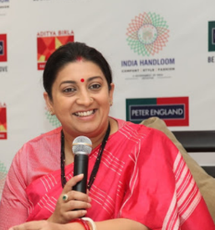
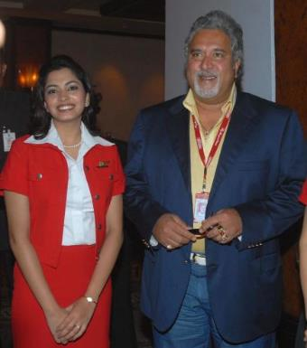
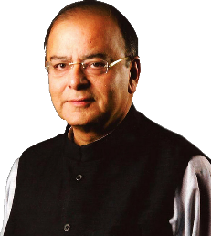
Btw, Government has taken steps…
Textile ministry will contribute this pink part for 3 years. (2016, textile employment generation package)
Salary <15k
12% contribute to EPF (provident)
Employer
12% contribute
8⅓ EPS
3⅔ EPF
2016: Pradhan Mantri Rozgar Protsahan Yojana: Labour ministry will pay this Orange part for 3 years for new recruit.

Slide 11
Mock Question for Prelims
The purpose(s) of Pradhan Mantri Rozgar Protsahan Yojana is / are
Provide capital loan subsidies to MSME sector if they hire more workers.
Provide loan subsidies to ITI and NSDC certificate holders to startup their own business.
Encourage employers to hire workers with written job contracts and thereby create formal jobs in the economy.
All of the above.

Slide 12
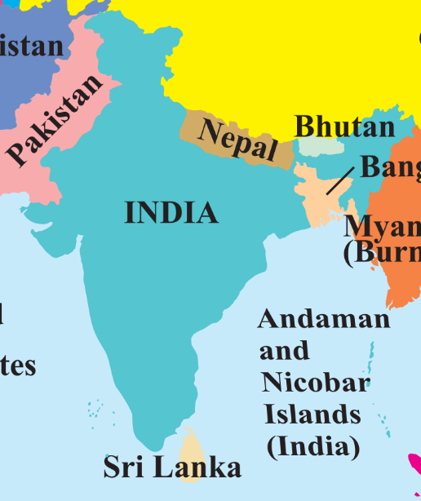
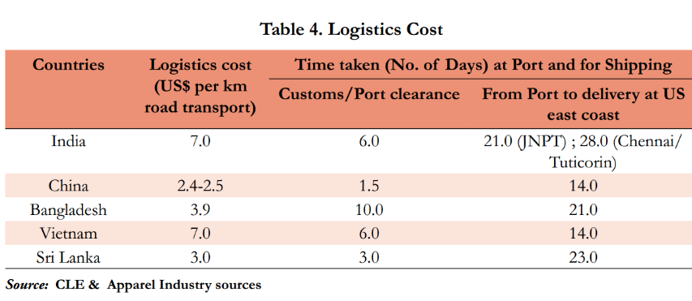
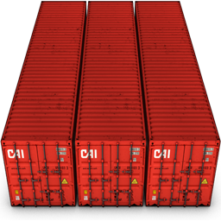
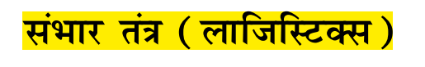
Clothes, shoes: Labour is plenty but 1) Labour laws 2) logistics
India takes more time for custom clearance
India takes more time to deliver cargo to USA
Cargo
तो फिर इडली तंत्र क्या है?
Colombo:
Very large container ships

Slide 13


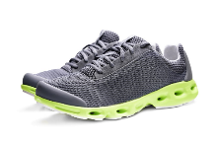
Labour law| logistics | Reason #3a: Tax, tariff policies [of India]
Under GST, we must rationalize these anomalies.

Slide 14
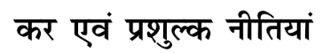
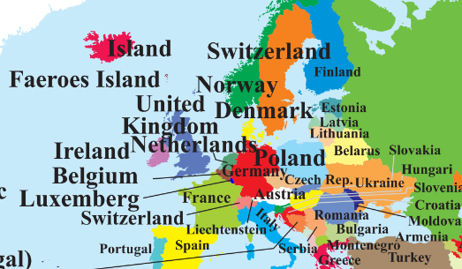
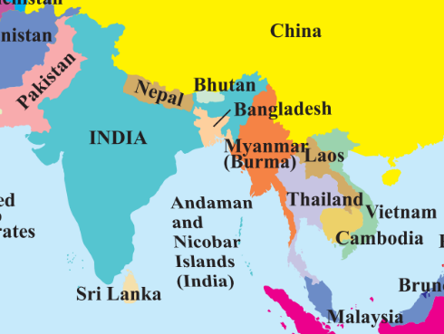
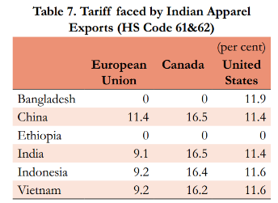
Reason #3b: Tax, tariff policies [of EU]
Bangladesh L.D.C: DQFQ
India 9-12% import tax
EU Vietnam Duty free agreement

Slide 15
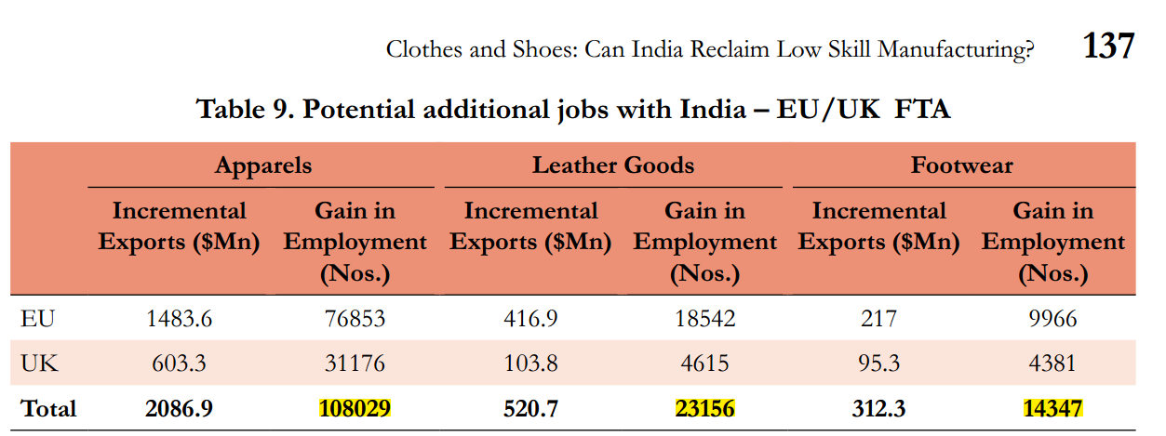
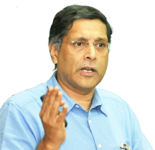
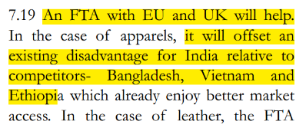
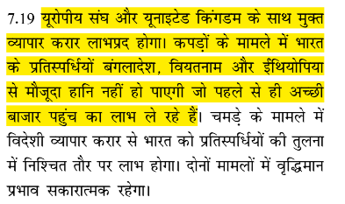
Therefore,

Slide 16
Mock Question for Prelims
According to Economic Survey 2016-17, which of the following factors have hampered the export of India’s textile and footwear industries?
Majority of Indian units in these two sectors are small sized and relying on informal workers.
Absence of free trade agreements with our export markets
Our wages are higher than that of China.
Answer Choices
a) Only 1 and 2 (b) Only 2 and 3
c) Only 1 and 3 (d) all of them

Slide 17
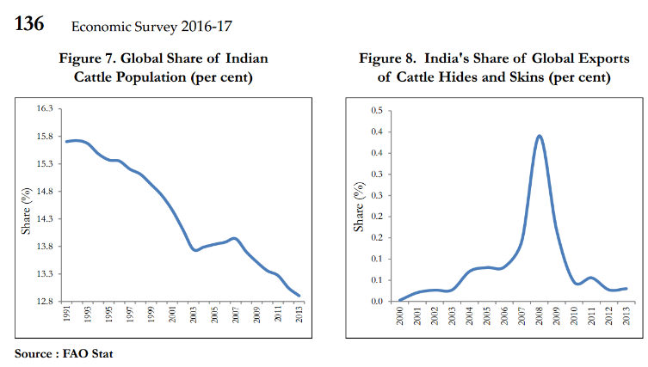
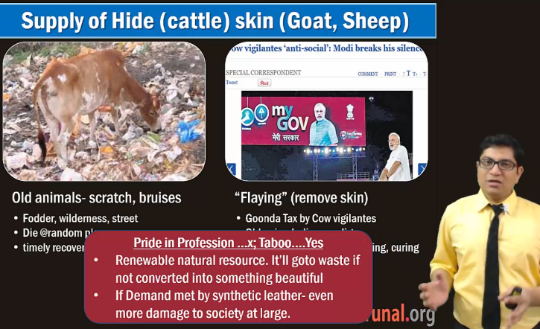
Leather industry specific challenges:
Footwear Design and Development Institute Bill, 2017 ->
Already present, under Comm. Ministry. Make it institute of national importance with governing council. (grant, degree etc benefits.) <ignore. Cost:benefit bad for competitive exams>
Mains Revision 2016
SELF Study link

Slide 18
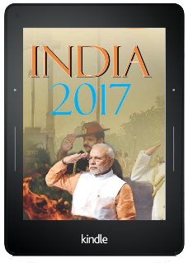

It doesn’t mean we are not doing anything to improve!?
Clothes and shoes
Consumer Affairs Ministry-> Bureau of Indian Standards (BIS)-> ISI mark so you’re assured of ‘helmet quality’. Similarly,
2015: Textile ministry-> India Handloom Brand: 2015- certification for "hand woven, natural fiber, safe dyes, no defect, no child labour.“

Slide 19
Ministry of textile
Handicraft
2015: National Handicraft Development program
Dastkar Shashktikaran Yojana
Form-SHG
loan DBT, training, marketing support,
Ambedkar Hastshilp Vikas Yojana “Cluster dev”
Weavers: Credit Card (2012)
Central wool board: promote Pashmina wool products from Ladakh & Kargil

Slide 20
Descending order was asked in CDS/CAPF once
Indian Silk
Central Silk Board (CSB) is a Statutory Body under
Ministry of Textiles

Slide 21
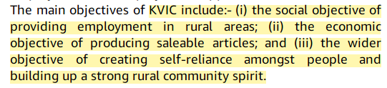
3 function verbatim asked in CDS/CAPF
KVIC
Khadi and village industries commission Act 1956
Under MSME ministry

Slide 22
Mock Question for Prelims
Find correct pair:
Bureau of Indian Standards: India Handloom Mark
Ambedkar Hastshilp Vikas Yojana: Khadi and Village industries Commission (KVIC)
Central Silk Board: Ministry of Agriculture
None of the above.

Slide 23
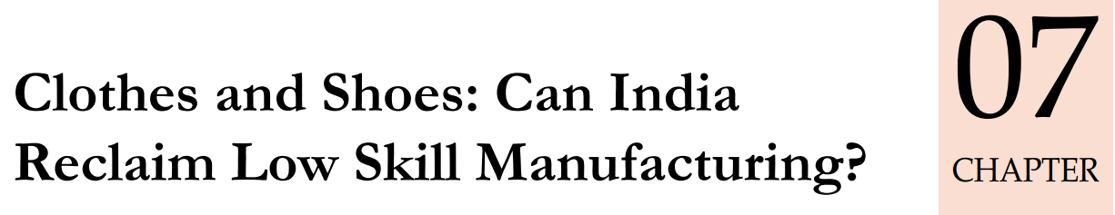
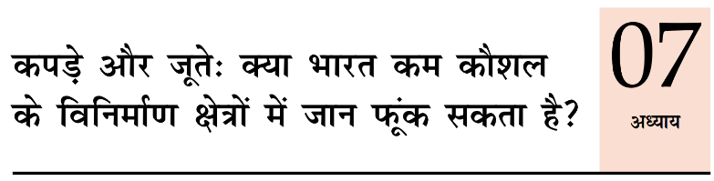
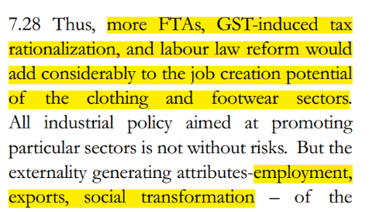
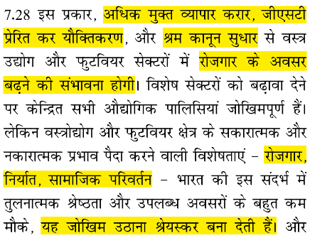
Labour law
Tax-Tarrif
GST
FTA
EU|UK
Bahubali 2
The
Conclusion

Slide 24
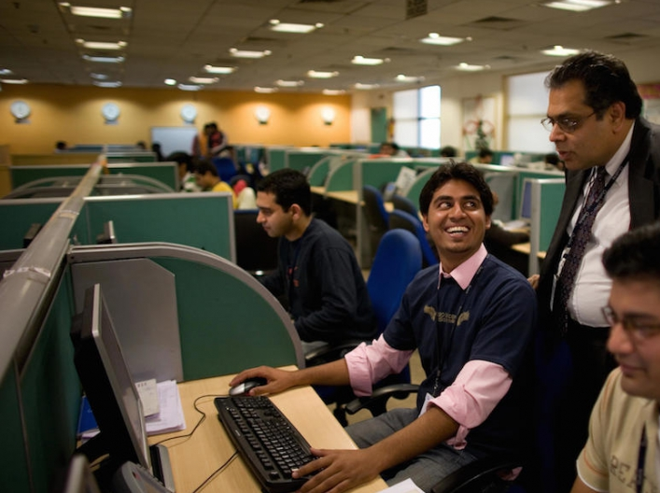
BES174: Sectors of Economy ►
Service Sector

Slide 25
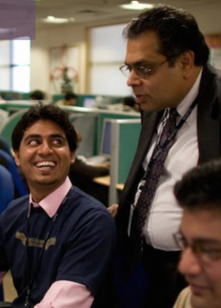

SERVICE
Sectors of economy
Vol2: ranking, import, export, GVA…x (Cost benefit)
IT – largest FDI, but patent, innovation is less.
Travel, Tourism (Infra lecture BES17”5”)
Startup “Bubble” (already taught in BES164)
Urban nuclear families: FMCG trade [breakfast: Paratha- Kellogg's, Pickles, papad- readymade..but that’s all for GSM3/Food processing.]
TRADE = “SERVICE”..
33 pages bol-bachchan ► 13 slides

Slide 26
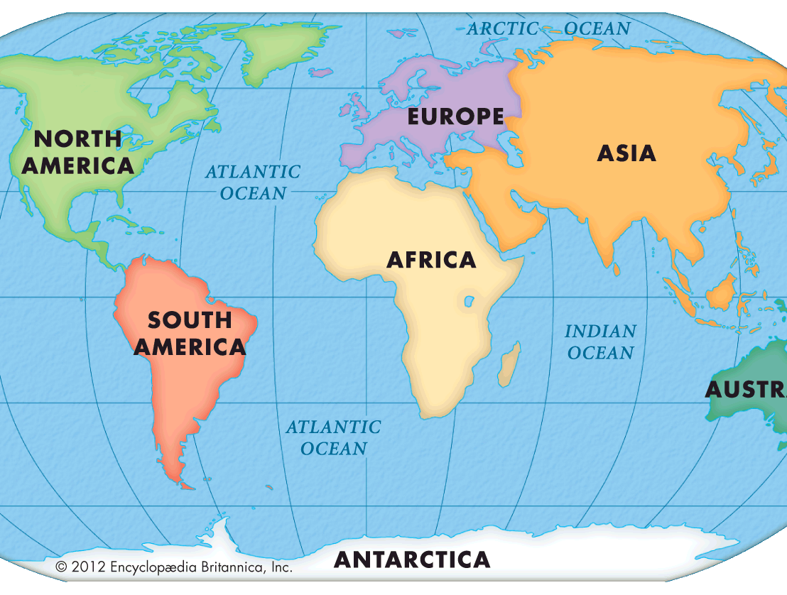

Last year Survey (BES16): Foreign trade variables
Direct proportion to size of economy
Inverse proportion to “Distance”
Language, Policy, Political system
Notes:
Evergreening = above 20 years.
trade flows between countries are directly proportional to the “size” of the two countries - as measured by GDP - and inversely proportional to the distance between them. Distance is a proxy for all trade costs between countries, including not just transport costs, but also those related to language, currency, policy etc. The idea being that countries having a similar language, currency, political system or colonial links are more likely to trade with each other because all costs other than transportation will be lower

Slide 27

This year (BES17): now let’s test it for India’s internal trade!!
variable
Theory
Reality
Distance ▲
Trade ▼
“less elastic” than USA
Language barrier ▲
Trade ▼
No evidence for “arms length” trade.
GSDP
Rich should trade with rich
“less elastic” than USA
How is this possible?
कुछ तो गडबड है दया !
Notes:
Evergreening = above 20 years.
trade flows between countries are directly proportional to the “size” of the two countries - as measured by GDP - and inversely proportional to the distance between them. Distance is a proxy for all trade costs between countries, including not just transport costs, but also those related to language, currency, policy etc. The idea being that countries having a similar language, currency, political system or colonial links are more likely to trade with each other because all costs other than transportation will be lower

Slide 28


Anomaly reason#1: Area Based Exemption…
variable
Theory
Reality
Distance ▲
Trade ▼
“less elastic” than USA
GSDP
Rich should trade with rich
“less elastic” than USA
Railway: Cross subsidization=
Cost of moving goods
= ▲ ☹
Not good for End user
Notes:
Evergreening = above 20 years.
trade flows between countries are directly proportional to the “size” of the two countries - as measured by GDP - and inversely proportional to the distance between them. Distance is a proxy for all trade costs between countries, including not just transport costs, but also those related to language, currency, policy etc. The idea being that countries having a similar language, currency, political system or colonial links are more likely to trade with each other because all costs other than transportation will be lower

Slide 29


Anomaly reason#2: CST & VAT
Merchant
Within state: purchase = VAT credit
But Andhra doesn’t provide credit on automobile parts, construction material.
Better to buy where ‘rate-arbitrage’. CST dodge via warehousing.
variable
Theory
Reality
Distance ▲
Trade ▼
“less elastic” than USA
Language
Trade ▼
No evidence for “arms length” trade.
warehousing
warehousing
Form-F vs Form-C
Notes:
Evergreening = above 20 years.
trade flows between countries are directly proportional to the “size” of the two countries - as measured by GDP - and inversely proportional to the distance between them. Distance is a proxy for all trade costs between countries, including not just transport costs, but also those related to language, currency, policy etc. The idea being that countries having a similar language, currency, political system or colonial links are more likely to trade with each other because all costs other than transportation will be lower

Slide 30


VAT/ CST: Rate arbitrage, tax distortion
Since Andhra et al don’t give VAT input credit on certain domestic products…better to import from other state to make more profit..

Slide 31


End result: Internal trade is __ times the Foreign trade
Internal trade >> Foreign trade
foreign trade
>> Internal
1.6x
1.7x
foreign trade
>> 2.5x Internal trade
Not “Genuine” growth in trade
CST/VAT
Hopefully GST will fix.. ☺
Excise: area based exemption
Just like how DT >> iDT in 1st world.
iDT >> DT in 3st world.

Slide 32
Mock Question for Prelims
A) India’s internal trade is larger than its foreign trade in terms of value.
R) India is following the developmental trajectory of a “normal” emerging market economy.
Answer Options:
Both are correct and R explains A
Both are correct but R doesn’t explain A
A is right but R is wrong.
R is right but A is wrong.
Hint: Precocious and cleaved India lecture.

Slide 33

Foreign trade Mercantilism view: exports good, import bad on that logic, we must foreign trade (export) >> internal trade!
Ease of doing biz.
Governance, infra. ☺
Aid Curse, Resource Curse, Poor Governance
“Rich states” Usually
= Positive trade balance
UP and Haryana, though agri-states but now becoming mfg-powerhouses due to proximity with NCR. But need to improve this ease of doing biz. And
Create “one economic India”: 1 form, 1 registration, 1 tax.

Slide 34

Territorial 1 India ☺ economic 1 India ☹
Constitution
301: free trade, commerce, intercourse throughout India
302: but parliament can impose restrictions, for public interest
303: but parliament / SLA must not ‘discriminate’ among states.
304: but SLA can impose taxes, but must not discriminate
304/b: SLA can impose restriction for public interest, but bill needs presidential nod.

Slide 35
Territorial one India economic one India..x
Constitution
J&K State sales tax:
none for local edible oil
4-8% for outsider maal.
Shree Mahavir Oil Mills->SC case (1996)..favoured J&K state Government.
SC: state can impose taxes/barriers on “outside” goods, to protect local industry. But must use that Rs. For local industry development. But 2016: Jindal industry case, SC rejected this “compensatory tax’ theory.

Slide 36
Territorial one India economic one India..x
Constitution
Still, states permitted to levy ‘entry’ tax (7th Sch. Empowers them). This is conflicting with
USA Constitution: “truly federal”:
Residuary powers are with states, but for inter-state trade, only US Congress (Lok Sabha) can make laws.
Hence internal barriers and tax distortion less than India’s. so USA’s foreign trade = 2.5x interstate trade. [India ☹]

Slide 37
Mock Question for Prelims
Which of the following statements are correct about India’s Inter-state trade?
Rich states mainly trade with rich states while poor states mainly trade with poor states
States having similar language and culture trade more with each other and states with dissimilar language and culture trade little with each other.
Both parliament and state legislative assemblies are empowered to put reasonable restrictions on the entry of goods in and out of the given state.
All of above.

Slide 38

Both wanted freedom of trade and commerce, EXCEPT..
Constitution
WTO
Public interest: parliament can impose restrictions
Public Morals: Member can impose restrictions: [Netherland’s marijuana, US’s automatic guns for ‘citizens’, China’s Prison Labour]
Also on Gold, silver, Natural resources, Archeological Treasure.
States “Entry Tax”
Members can impose “Border Tax”
Both say ‘protection’ to some extend necessary.
Makers wanted to stop breakup, hence states given more powers but now unnecessary.
But have to integrate one territorial India to one economic India via GST among other “Constitutional” reforms.
E.g. APMC, Tax on agriculture income.

Slide 39

Economy: 6 pillars + theory + current + BES17 (pre cum Mains)
1.Banking, Fin, Insur.
6.HRD
2.Budget
3.BoP
4.Sectors
5.Infra
V1:c3,4
V1:c2,3, 6,9,11(GST),13
V1c:5
V1c:7(Textile),11(trade)
V1c:10
v1c:12, 14; Budget^Rail
11 pages bol-bachchan ► 12 slides
33 pages bol-bachchan ► 13 slides
NEXT GDP, IIP, CPI, WPI etc. “Indexes”
+ Demonetization impact on them.

